Slide 1


Skill Based Lab Mini Project
Aldel Education Trust’s
St. John College of Engineering and Management, Palghar
Autonomous | NAAC Accredited with Grade A+ | NBA Accredited
DEPARTMENT OF COMPUTER ENGINEERING
Sentiment Analysis on Hotel Reviews using Machine Learning
Swijel Dmello
(Comps/A | Roll no.: 05 ) [EP1241011]
Guide: Ms. Shraddha More| Assistant Professor
December 05, 2024
‹#›

Slide 2
Contents
Introduction
Motivation
Problem Statement
Technical Aspects
Scope
Review of Existing Literature
Proposed System
Block diagram of Proposed System
Implementation
Algorithm/Flowchart
Dataset
Pseudo code
Screenshots of the output with description
Technologies Used
Results and Discussion
Conclusion and Future Work
References
Department of Computer Engineering | SJCEM
‹#›

Slide 3
Introduction
Problem Statement:
Develop an ML driven system to detect and filter out fake online reviews, enhancing the credibility of review platforms.
Technical aspects:
Investigating how machine learning techniques can be applied to differentiate between genuine and fraudulent reviews, minimizing user exposure to deceptive information.
Motivation:
Fake reviews not only affect the user’s trust but also has an impact on the sales of the commodity.
Scope:
The ultimate goal of the system is to aid consumers in making better-informed choices by eliminating fake reviews

Slide 4
Review of Existing Literature
Sr. No. | Title of paper | Database used | Algorithms & methods used | Research Gap
1 | An Empirical Study on Detecting Fake Reviews Using Machine Learning Techniques | Movie reviews dataset | Sentiment Analysis, NB, DT-J48, KNN-IBK and SVM | Collusion and manipulation issues weren’t addressed.
2 | Spotting and Removing Fake Product Review in Consumer Rating Reviews | online shopping reviews dataset | Support Vector Machine (SVM) | Comparison of various algorithms.
3 | Sentiment analysis on Chinese movie review with distributed keyword vector representation | Chinese movie review dataset | TF-IDF and LLR NB, DT-J48, KNN-IBK and SVM | Accuracy is not quite good
4 | Fake Review Detection on Yelp Dataset Using Classification Techniques in Machine Learning | Dataset of reviews on restaurants and hotels | Logistic Regression, NB, XGBoost, SVM | Imbalance in the dataset is to be handled.
5 | Fake review detection review using Behavioural and Contextual features | pseudo fake ,real life reviews | SVM,decision trees ,random forest | Limited dataset
6 | A Method for the Detection of Fake Reviews Based on Temporal Features of Reviews and Comments | Amazon-China shopping dataset | Isolation forest, bayesian network | Less precision

Slide 5
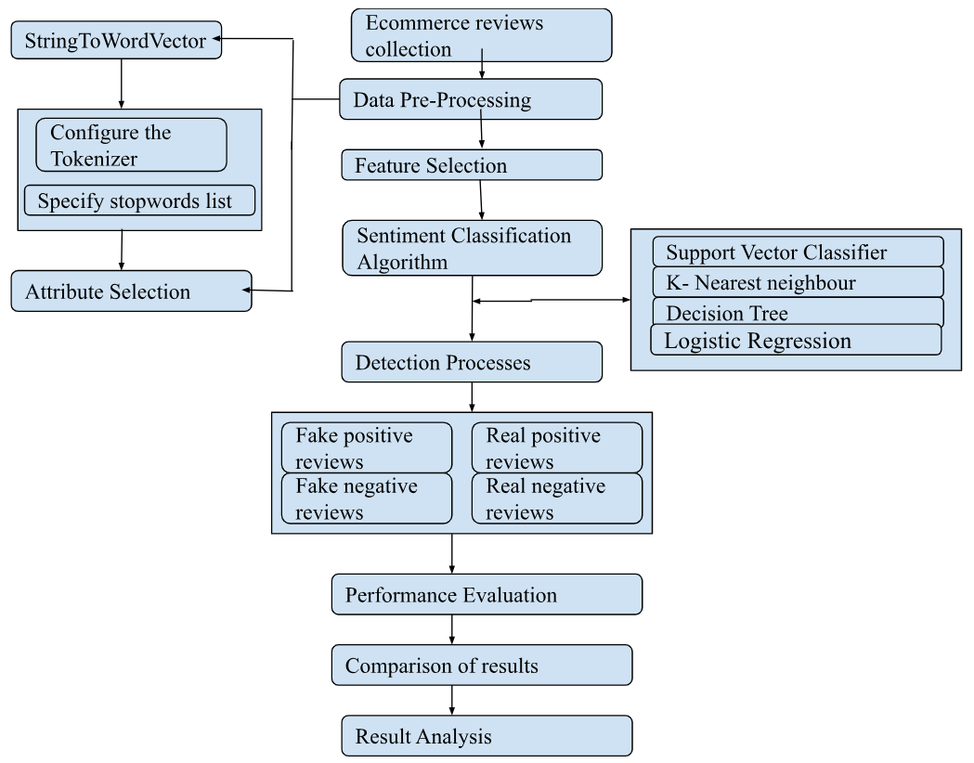
Proposed System

Slide 6
Implementation
Dataset:
Corpus of truthful and deceptive hotel reviews of 20 Chicago hotels.
The dataset is provided by cornell.edu.in.
Code snippet section:
from sklearn.svm import SVC
svc = SVC()
svc.fit(training_data, y_train)
svc_predictions = svc.predict(testing_data)
Output:
For SVC :
Accuracy score: 0.905
Precision score: 0.9033816425120773
Recall score: 0.9121951219512195
F1 score: 0.9077669902912622

Slide 7



Technologies Used
Python
Jupyter Notebook
Machine Learning
Sentiment Analysis

Slide 8
Results and Discussion
Sr. No. | Algorithm Implemented | Accuracy | Precision | Recall | F1 Score
1. | Support Vector Classifier | 0.905 | 0.903 | 0.912 | 0.908
2. | K-Nearest Neighbors | 0.790 | 0.885 | 0.678 | 0.768
3. | Decision Tree | 0.647 | 0.693 | 0.561 | 0.619
4. | Logistic Regression | 0.900 | 0.895 | 0.912 | 0.903

Slide 9
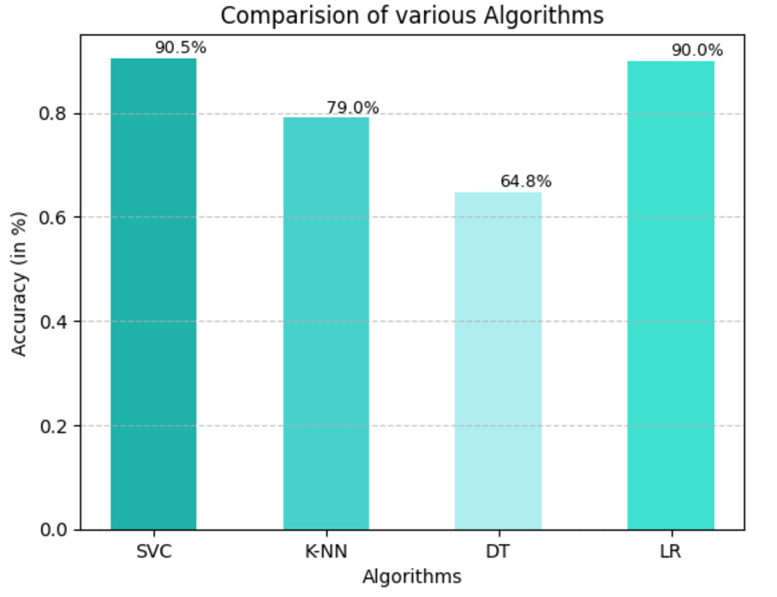
Results and Discussion

Slide 10
Conclusion and Future Work
The current model is trained using the existing dataset which shows that the model performs well against it.
The model that achieves the highest accuracy is SVM using the RBF kernel and the highest accuracy score is 90.5%.
Increase the variety and volume of data used for model training, leading to improved accuracy and reliability in detecting fake reviews.
Incorporating different languages in our system for removing language barrier between AI and user
Integrating the system with a real hotel management system for better accessibility and real time accuracy

Slide 11
References
Parikh, S. B., & Atrey, P. K. (2018, April).Media-Rich Fake News Detection: A Survey. In 2018 IEEE Conference on Multimedia Information Processing and Retrieval (MIPR) (pp. 436-441). IEEE.
Y. Li, X. Feng, and S. Zhang, “Detecting Fake Reviews Utilizing Semantic and Emotion Model,” 2016 3rd International Conference on Information Science and Control Engineering (ICISCE), pp. 317–320, 2016.
J. Kamps, M. Marx, R.J. Mokken, and M. Rijke, “Using WordNet to measure semantic orientations of adjectives,” Proceedings of the Fourth International Conference on Language Resources and Evaluation, vol. IV, pp 1115-1118, 2004.
B. Pang, L. Lee, and S. Vaithyanathan, “Thumbs up? Sentiment classification using machine learning techniques,” Proceedings of EMNLP, pp. 79-86, 2002.
https://www.kaggle.com/code/manvichaudhary2003/fake-reveiw-detection-on-yelp-dataset/notebook
https://github.com/SayamAlt/Fake-Reviews-Detection
https://ieeexplore.ieee.org/stamp/stamp.jsp?tp=&arnumber=9416474
https://www.kaggle.com/datasets/omkarsabnis/yelp-reviews-dataset/code

